Slide 1
128K x 8 CMOS Static RAM
Under the guidance of Dr. Kaushik Saha
Team Members:
Shashank Varshney
Vijay Sharma
Saurabh Mathur
Srishti Gupta
Ramyani Mukherjee

Slide 2
Memory Specifications
128K X 8 bit CMOS Static RAM (Cypress Semiconductors CY7C1019CV33
Key Features: Automatic Power down when deselected
Address Width : 17 bit (A0-A16)
Data Width: 8 bit (I₀/O₀- I₇/O₇)
Operating Voltage : 1V + 10%
Operating Temperature: Commercial (0º- 70º C)
Technology Node: UMC 65nm
Cycle Time : 15 ns (min)
Address to Data valid time : 15ns (max)

Slide 3
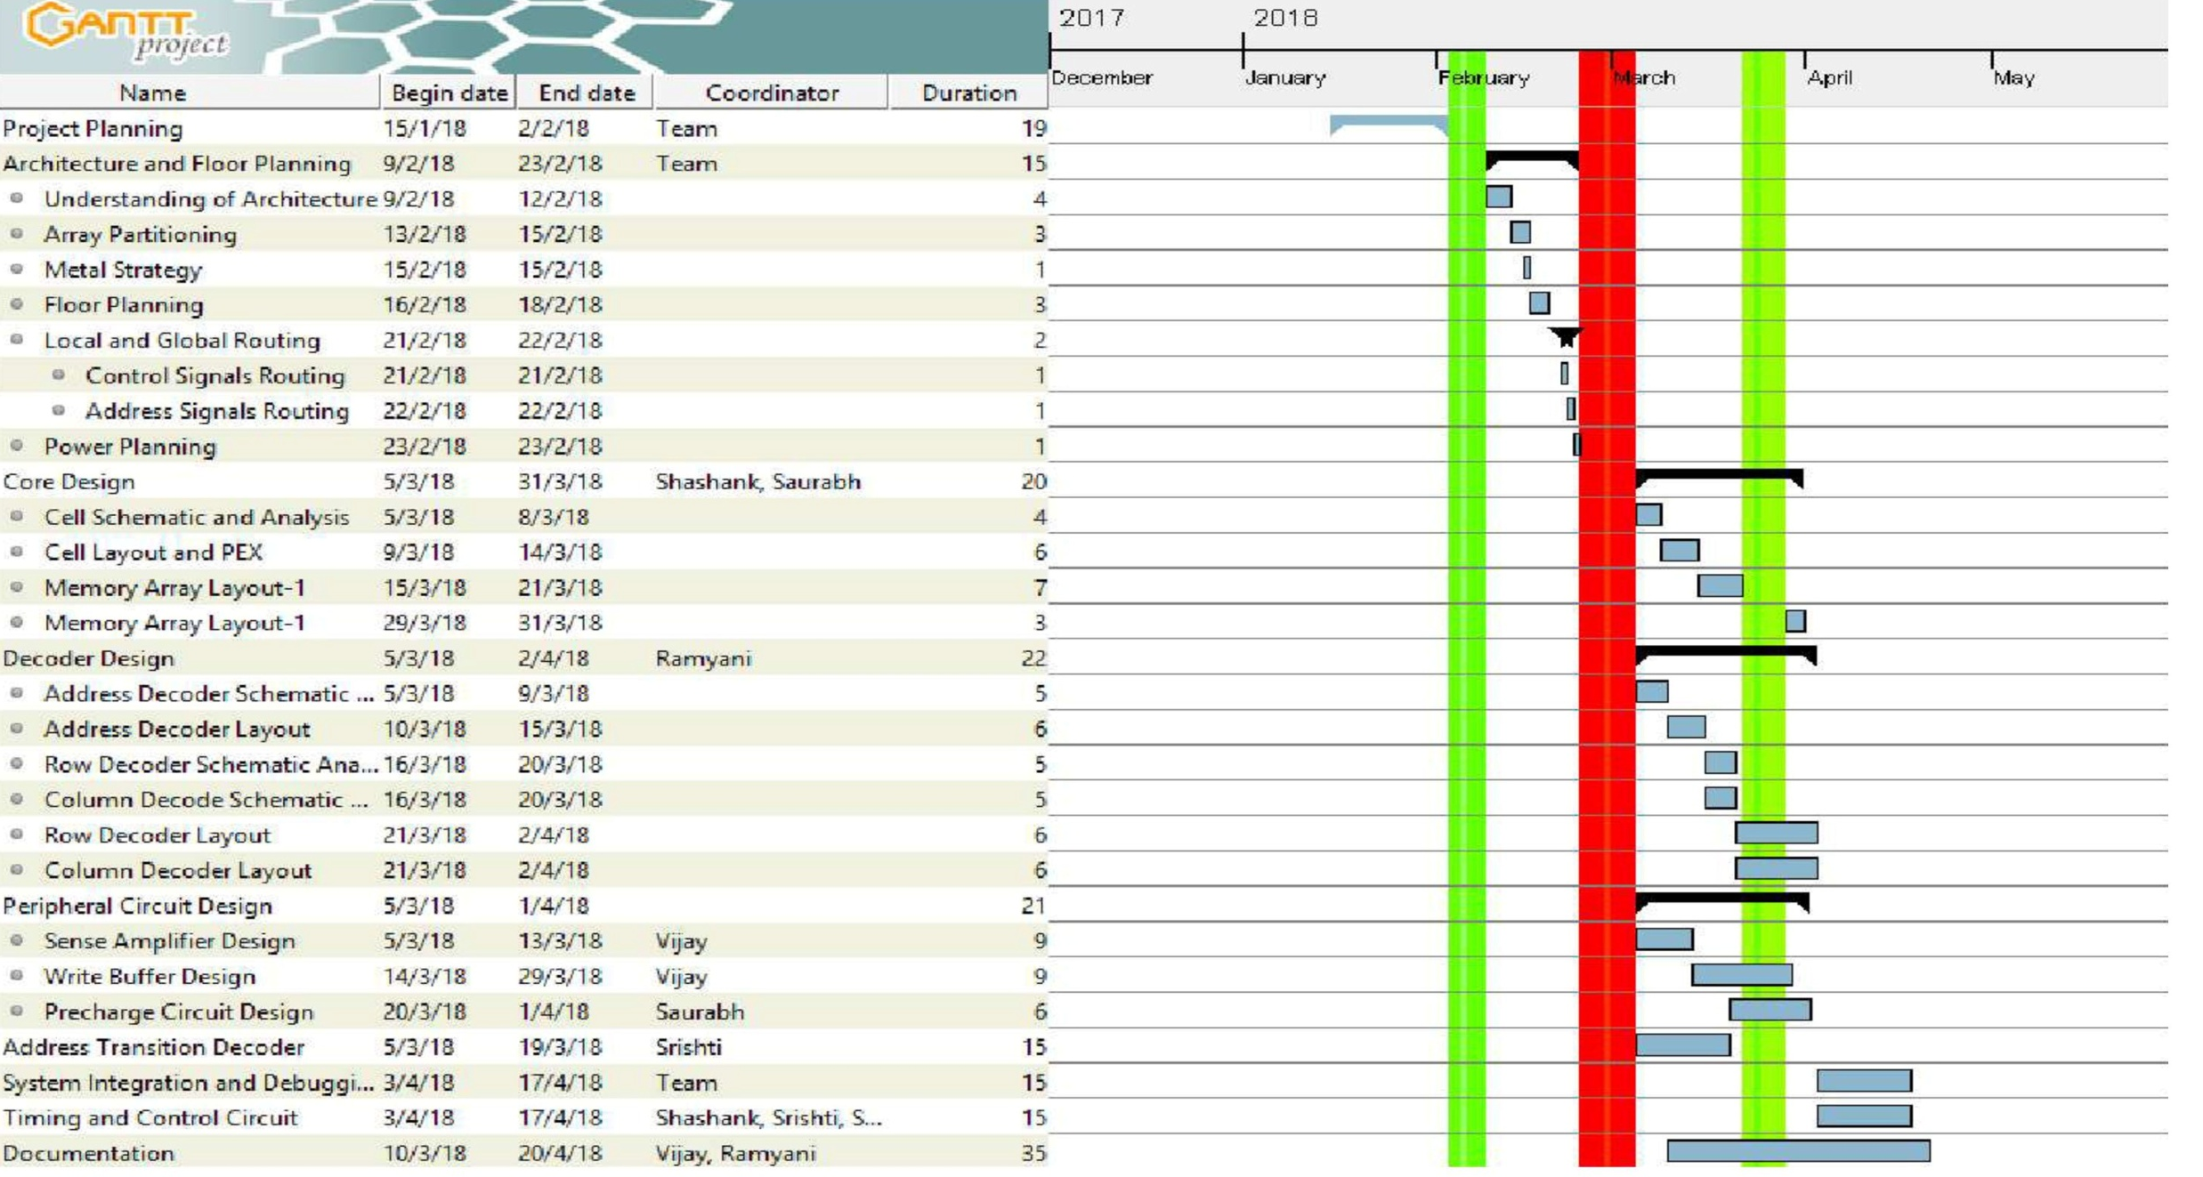
Gantt Chart

Slide 4
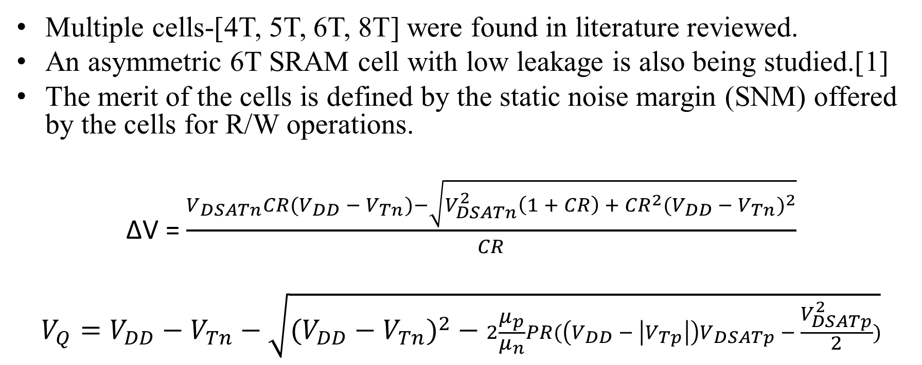
The SRAM Cell
Multiple cells-[4T, 5T, 6T, 8T] were found in literature reviewed.
An asymmetric 6T SRAM cell with low leakage is also being studied.[1]
The merit of the cells is defined by the static noise margin (SNM) offered by the cells for R/W operations.
∆V = $\frac{V_{DSATn}CR(V_{DD} −{ V}_{Tn})−\sqrt{V_{DSATn}^{2}\left(1 + CR\right) +{ CR}^{2}{(V_{DD }− V_{Tn})}^{2}}}{CR}$
$$V_{Q}=V_{DD}−V_{Tn}−\sqrt{{(V_{DD}−V_{Tn})}^{2} − 2\frac{μ_{p}}{μ_{n}}PR(\left(V_{DD} − \left|V_{Tp}\right|\right)V_{DSATp} − \frac{V_{DSATp}^{2}}{2})}$$

Slide 5
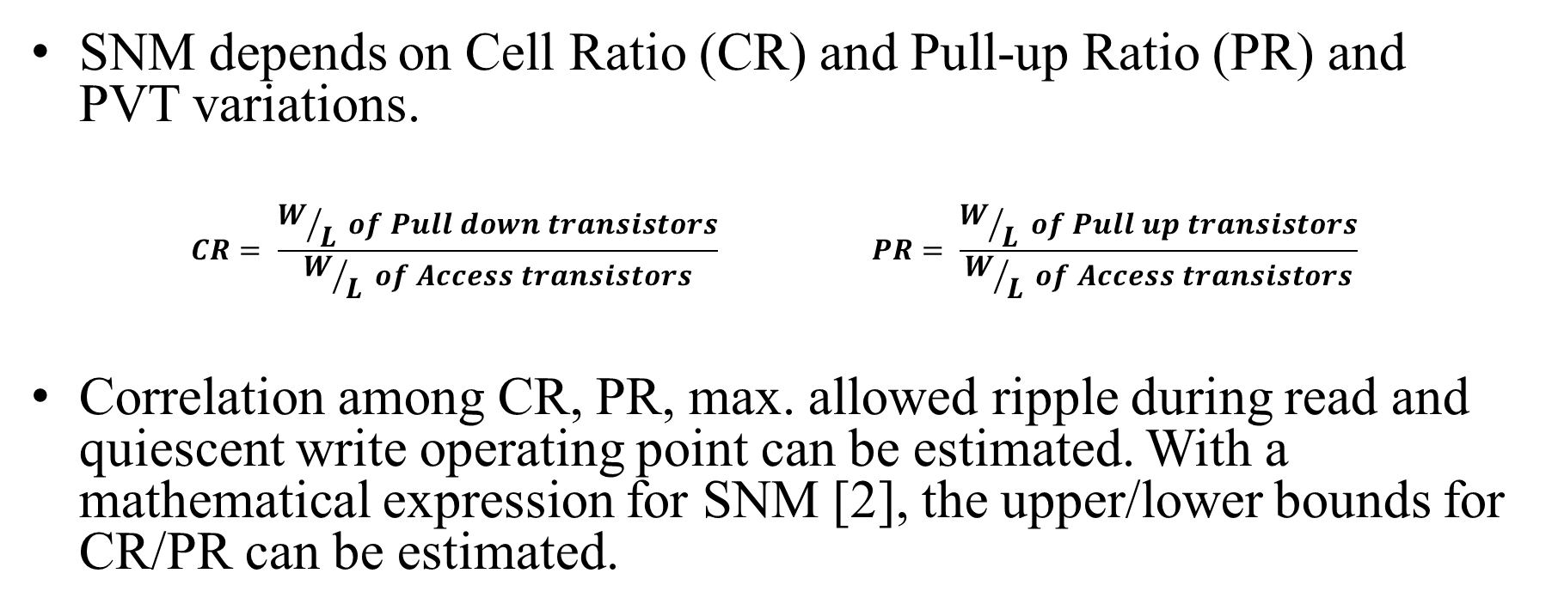
Contd.
SNM depends on Cell Ratio (CR) and Pull-up Ratio (PR) and PVT variations.
$$CR= \frac{W/L of Pull down transistors}{W/L of Access transistors} PR= \frac{W/L of Pull up transistors}{W/L of Access transistors}$$
Correlation among CR, PR, max. allowed ripple during read and quiescent write operating point can be estimated. With a mathematical expression for SNM [2], the upper/lower bounds for CR/PR can be estimated.

Slide 6
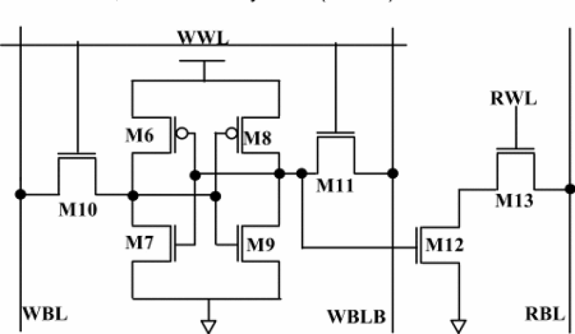
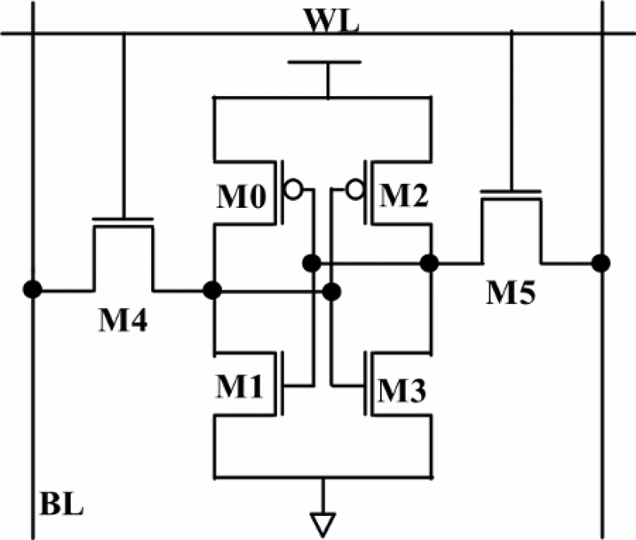
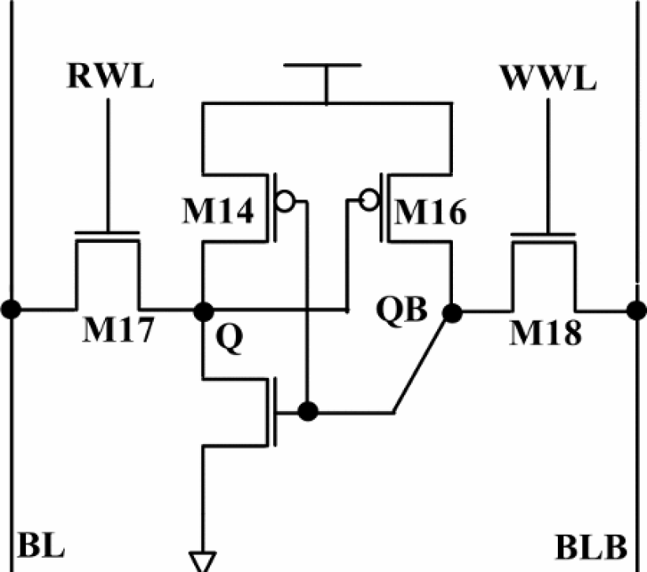
SRAM Cell topologies
(a)
(b)
(c)
Fig. 1 SRAM Cell Topologies a) 8T Cell b) 6T Cell c) 5T Cell
Ref. Anupreet Gupta, Hajra Anwer, B.S. Reniwal, S.K. Vishvakarma “Analysis of Stability Issues and Power Efficiency of Symmetric and Asymmetric Low Power Nanoscaled SRAM cells,” presented at the 2nd International Conference on Devices, Circuits and Systems (ICDCS), 2016.

Slide 7
Comparison of different of SRAM cells
Parameters | 5T Cell | 6T Cell | 8T Cell
RSNM (mV) | 202.8 | 135.5 | 340.9
WSNM (mV) | 380.7 | 347.5 | 346.4
HSNM (mV) | 300.4 | 311.2 | 312.3
Read Power(uW) | 9.4 | 17.2 | 9.3
Write Power(nW) | 39.2 | 39.1 | 39.3
Static Power(nW) | 0.21865 | 5529.77 | 5529.8
Ref. Anupreet Gupta, Hajra Anwer, B.S. Reniwal, S.K. Vishvakarma “Analysis of Stability Issues and Power Efficiency of Symmetric and Asymmetric Low Power Nanoscaled SRAM cells,” presented at the 2nd International Conference on Devices, Circuits and Systems (ICDCS), 2016.

Slide 8
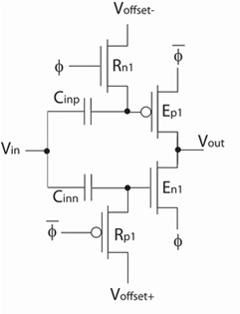
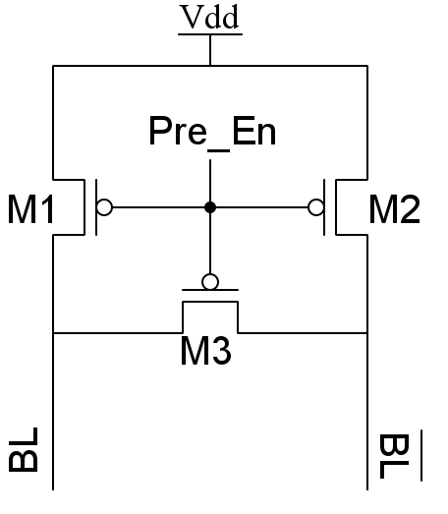
Pre-charge logic
Circuit implementations of different kinds were found.
A simple static version and a complete CMOS dynamic logic implemented version were studied. [1,4]
(a) (b)
Fig. 2 (a)A simple static pre-charge circuit
(b) Dynamic ultra low-voltage domino inverters.

Slide 9
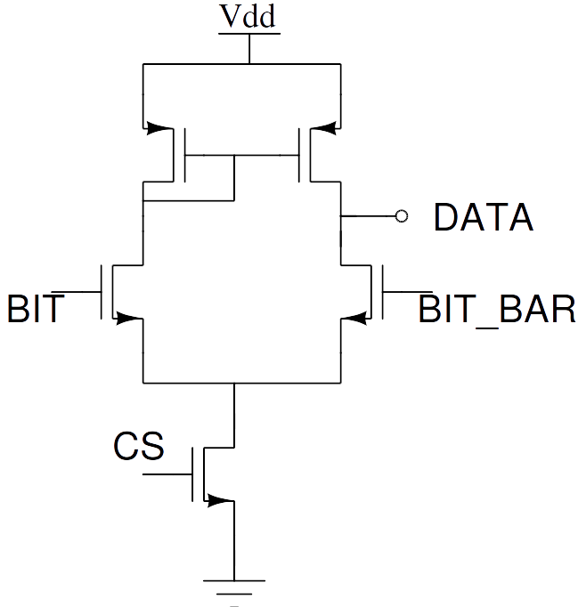
Sense amplifier
Sense amplifiers are basically differential amplifiers with high CMRR and can have a low gain of about 10.
There are multiple topologies which can be used to make a sense amplifiers which were studied.
A simple dual input single ended output differential amplifier can be used for this purpose.
Fig 3. Dual input single ended output differential amplifier

Slide 10
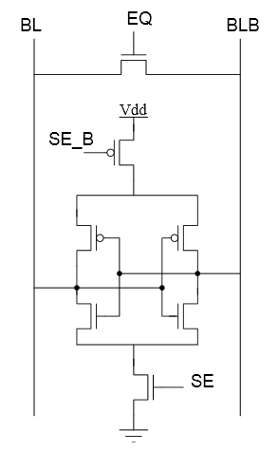
Contd.
A different approach is to use two inverters tied back to back .
An interesting fact about sense amplifiers is that we are not limited on the output voltage swing[4]

Slide 11
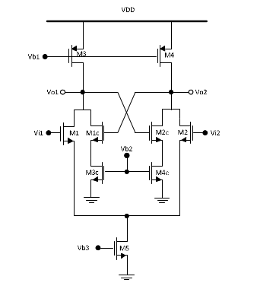
Contd.
This property can be exploited by using a positive feedback network incorporated in a classical analog differential amplifier.
Such a network was studied which used a cross coupled pair as a regenerating circuit.
Spice simulation of these three shortlisted candidates for making the sense amplifiers are to be carried out and the final decision is to be made based on the simulation results.[5]

Slide 12
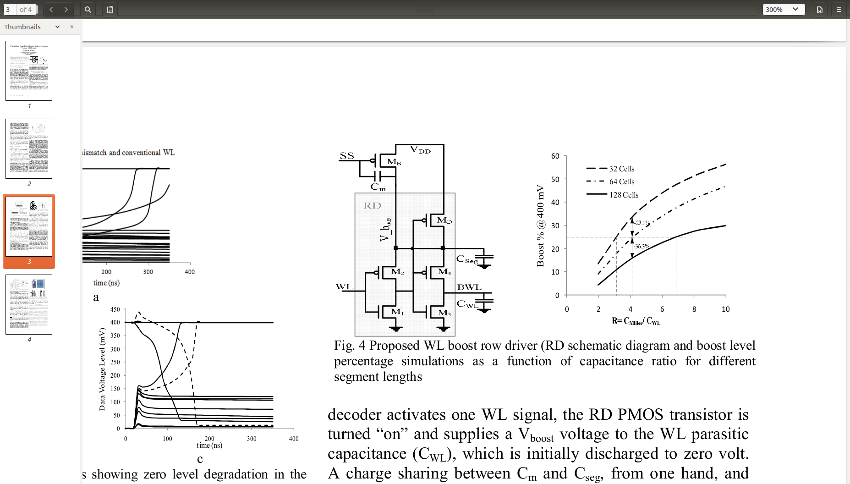
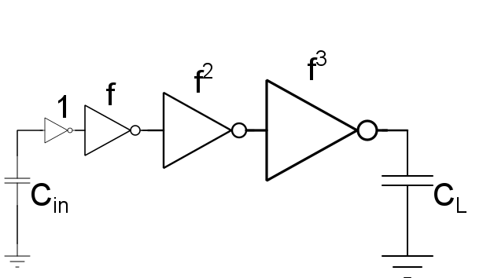
Word Line Driver
Increasing the access transistor strength helps in increasing the cell drivability (RDM) and the WRM.
This can be done by increasing the transistor overdrive voltage by boosting the world line.[8]

Slide 13
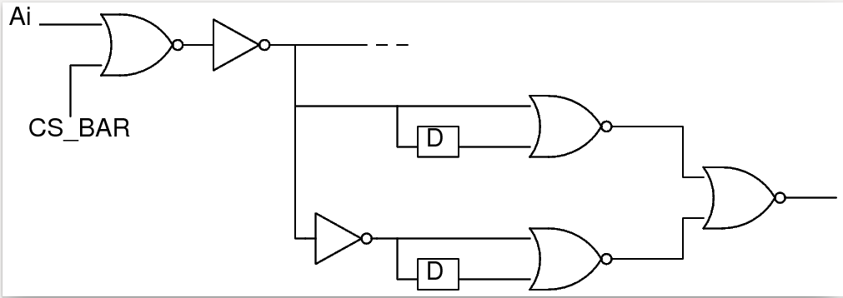
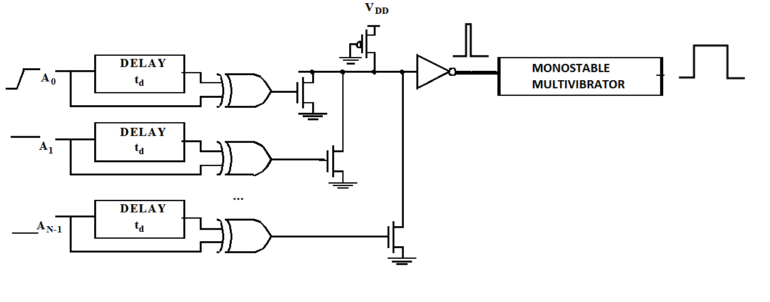
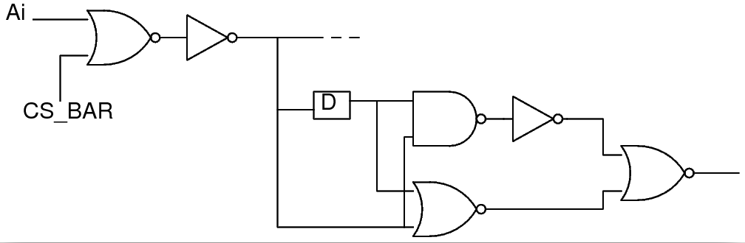
Address Transition Detector
ATD generates a short pulse every time there is a change in any of the address lines.
This pulse triggers the generation of a clock which makes the other blocks execute in the required sequence.[4] [7]

Slide 14
Decoder Circuitry
A hierarchical decoding scheme will be used to select the memory banks, wordlines and bitlines.
Pre-decoding to be done before decoding to reduce fan-in and delay.
Block Decoder for memory bank selection
Row Decoder for wordline selection
Column Decoder for bitline selection
Decoding circuitry can either be:
-Traditional using AND gates
-Novel decoder using stages of NAND and NOR gates and a replica inverter delay chain. This can reduce delay and power dissipation[6].

Slide 15
128K x 8 CMOS Static RAM
Under the guidance of Dr. Kaushik Saha
Team Members:
Shashank Varshney
Vijay Sharma
Saurabh Mathur
Srishti Gupta
Ramyani Mukherjee

Slide 16
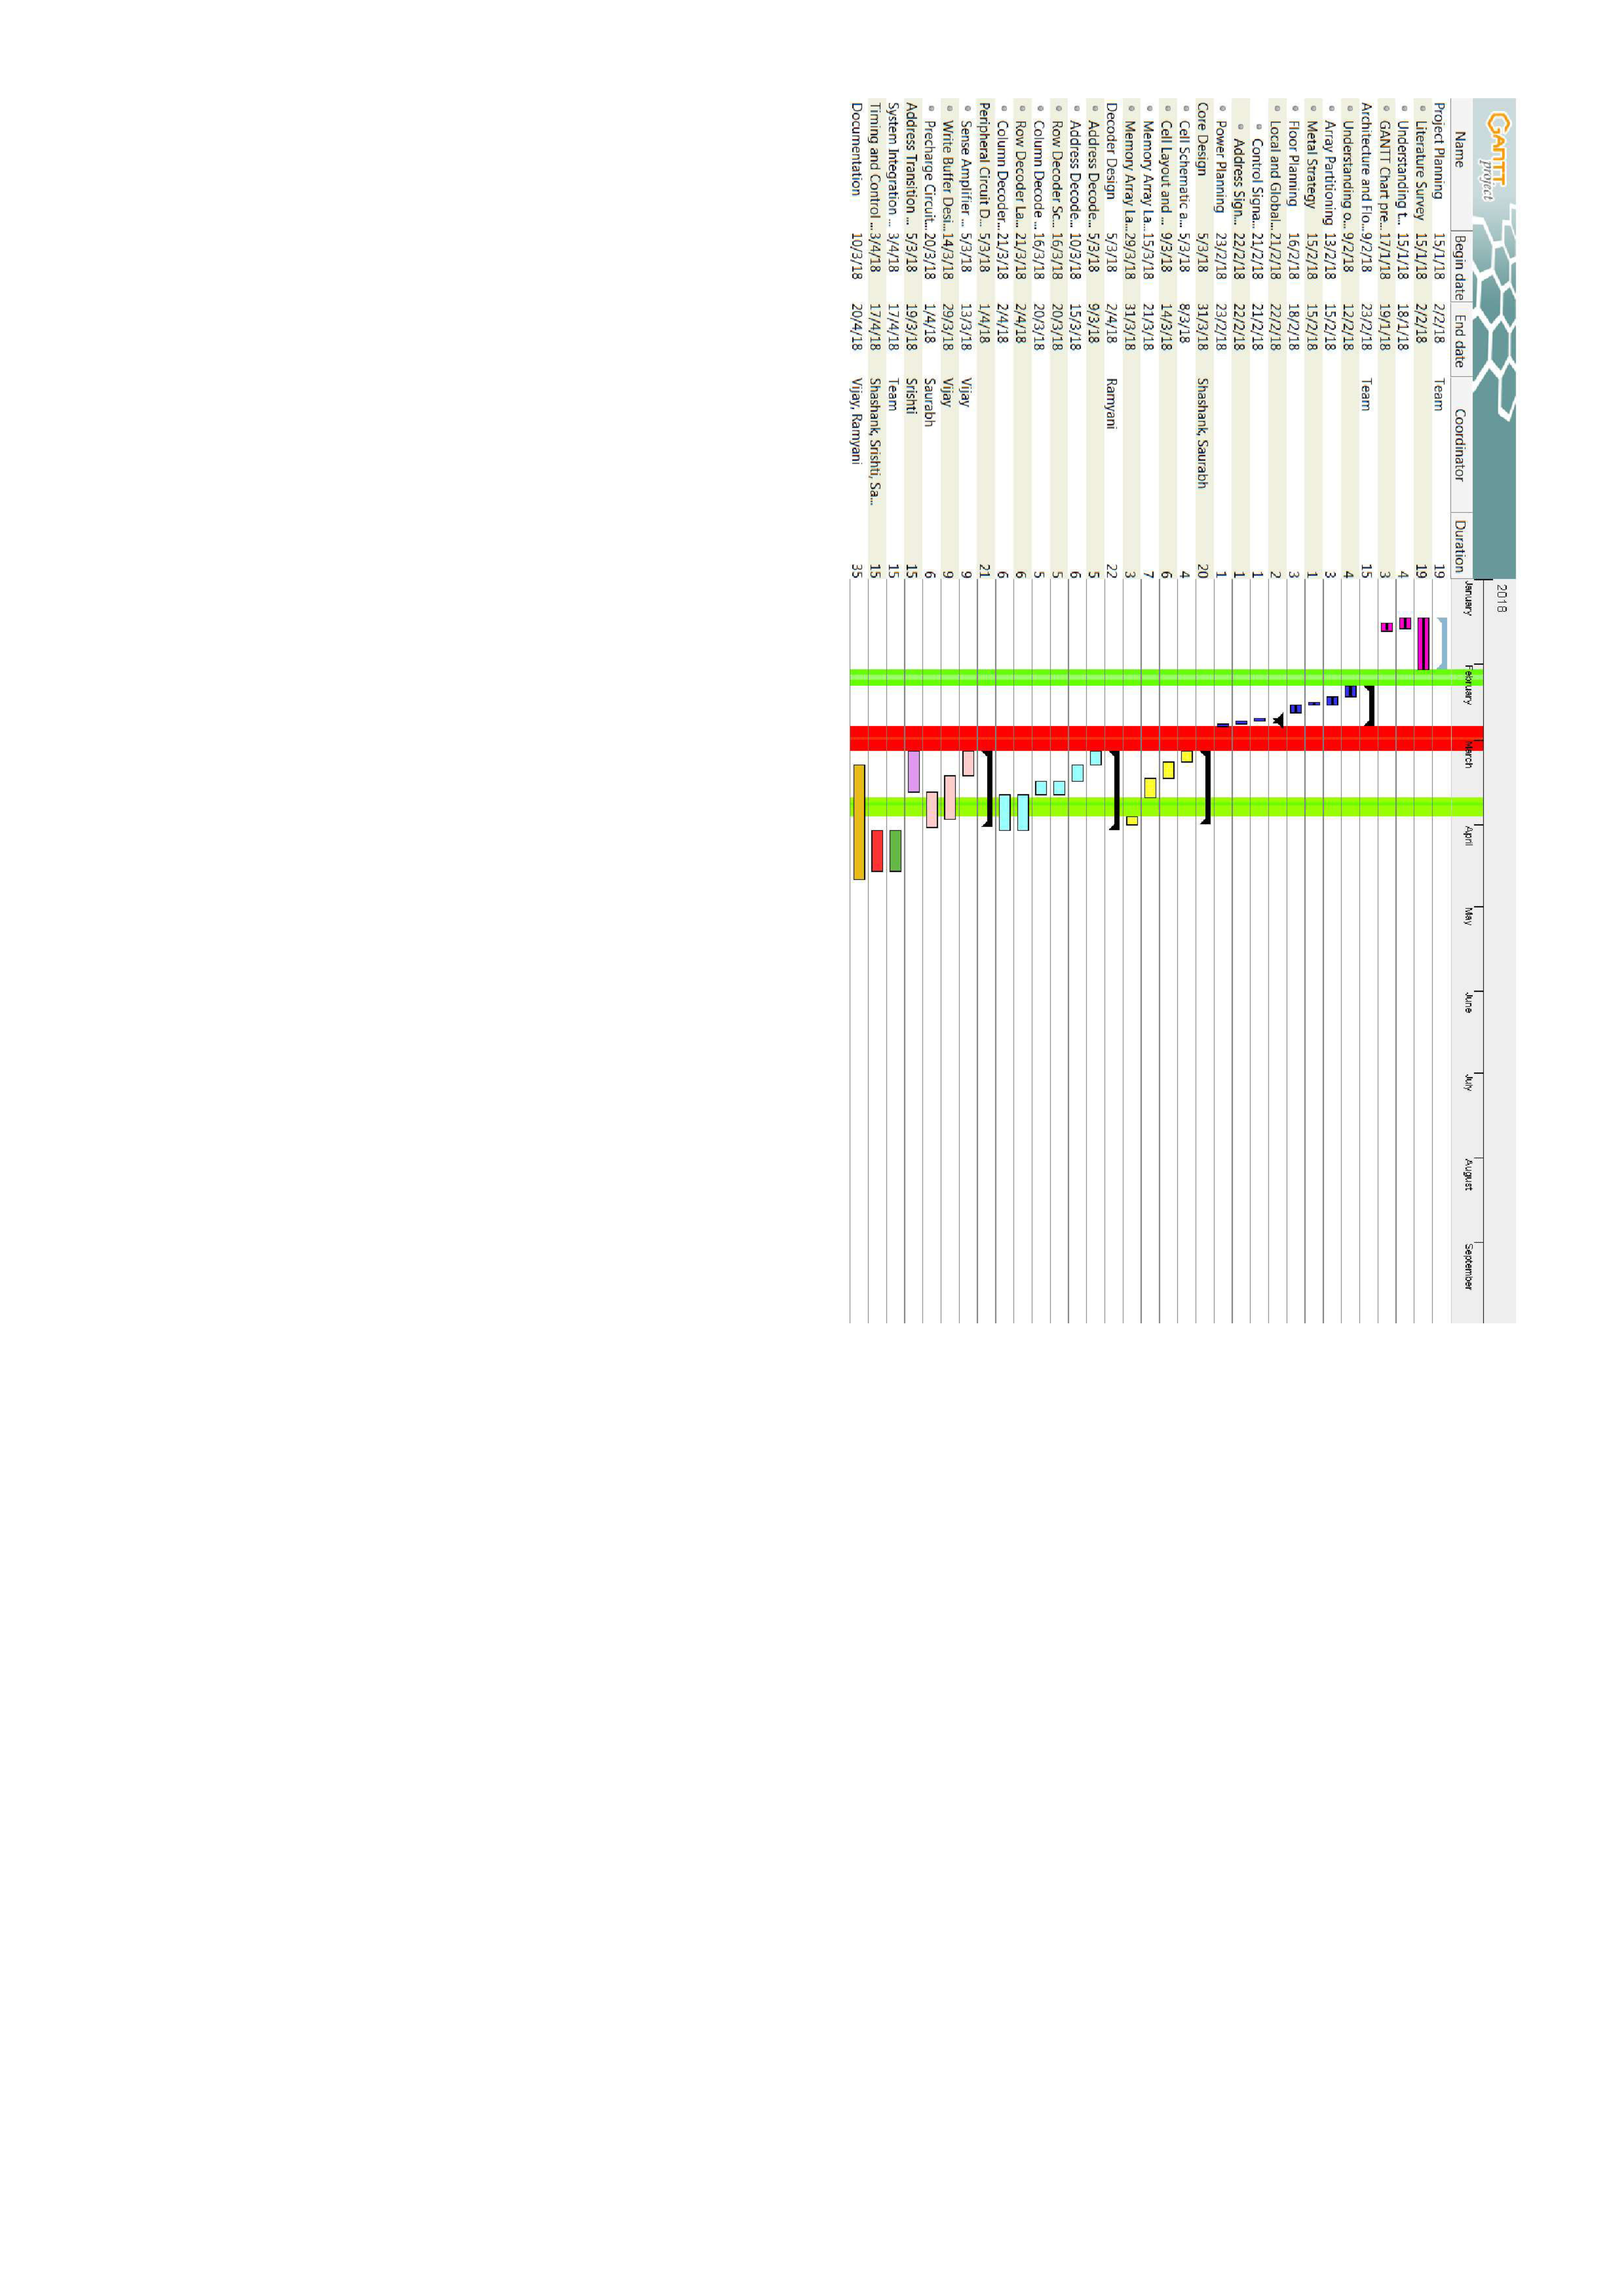

Slide 17
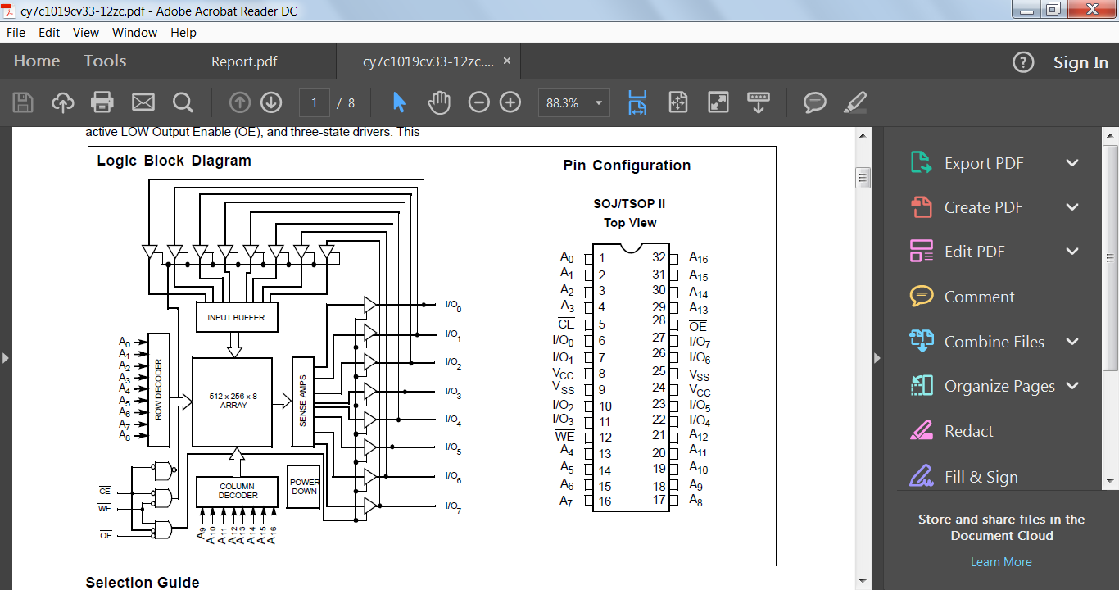
Pin Configuration
Pin Configuration

Slide 18
Metal Planning
Layers | Application | Resistance(sheet)(mῼ) | Capacitance( aF/μm)
Metal Layer 1 | Local Routing | 170 | 130.8
Metal Layer 2 | Word Line Strapping | 150 | 103.7
Metal Layer 3 | Bit Line | 150 | 86
Metal Layer 4 | Bit Line Complement | 150 | 76.5
Metal Layer 5 | Address Routing | 150 | 69.4
Metal Layer 6 | Control Routing | 150 | 69.4
Metal Layer 7 | VSS | 70 | 62.7
Metal Layer 8 | VDD | 70 | 68.3

Slide 19
Array Partitioning
t_{AA} = 10ns
Considering 2ns delay for I/O pad wire bond to package.
Dividing 8 ns equally among 4 major components for rough analysis, core delay = 2ns.
Assuming equal delay in rows and columns,
Row delay = 1ns
Column delay = 1ns

Slide 20
Array Partitioning

Slide 21
Array Partitioning
256 columns
Plotting the delays with respect to size, we get
Rows = 1150 & Columns = 264
This gives a size of 128x8 rows and 256 columns to be appropriate
However for improving speed we prefer smaller bank size to have smaller word line and bit line capacitances.
Therefore we opt for 8 banks of 16k x 8bits each .
But the decoder logic complexity increases exponentially as the number of banks increases and hence we don’t choose banks of smaller size.
64 X 8 Rows
16k X 8

Slide 22
Floor Planning and Routing

Slide 23
A₀
A₁₆
I
/O
BUFFERS
16K × 8 bit
SRAM Core
16K × 8 bit
SRAM Core
I
/O
BUFFERS
A₁
ROW DECODER
WRITE BUFFER
ROW DECODER
A₁₅
PRECHARGE
SENSE AMPLIFIER
PRECHARGE
SENSE AMPLIFIER
A₂
A₁₄
A₃
COLUMN DECODER
COLUMN DECODER
COLUMN DECODER
COLUMN DECODER
A₁₃
16K × 8 bit
SRAM Core
ROW DECODER
WRITE BUFFER
ROW DECODER
16K × 8 bit
SRAM Core
I/O₀
PRECHARGE
SENSE AMPLIFIER
PRECHARGE
SENSE AMPLIFIER
I/O₇
I/O₁
I/O₆
V_{CC}
V_{SS}
TIMING AND CONTROL CIRCUIT
ADDRESS TRANSITION DETECTOR
BLOCK DECODER
V_{SS}
V_{CC}
I/O₂
I/O₅
I/O₃
16K × 8 bit
SRAM Core
16K × 8 bit
SRAM Core
I/O₄
ROW DECODER
WRITE BUFFER
ROW DECODER
PRECHARGE
SENSE AMPLIFIER
PRECHARGE
SENSE AMPLIFIER
A₁₂
A₄
A₁₁
COLUMN DECODER
COLUMN DECODER
COLUMN DECODER
COLUMN DECODER
A₅
A₁₀
A₆
16K × 8 bit
SRAM Core
ROW DECODER
WRITE BUFFER
ROW DECODER
16K × 8 bit
SRAM Core
A₉
PRECHARGE
SENSE AMPLIFIER
PRECHARGE
SENSE AMPLIFIER
A₇
A₈

Slide 24
A₀
A₁₆
I
/O
BUFFERS
16K × 8 bit
SRAM Core
16K × 8 bit
SRAM Core
I
/O
BUFFERS
A₁
ROW DECODER
WRITE BUFFER
ROW DECODER
A₁₅
PRECHARGE
SENSE AMPLIFIER
PRECHARGE
SENSE AMPLIFIER
A₂
A₁₄
A₃
COLUMN DECODER
COLUMN DECODER
COLUMN DECODER
COLUMN DECODER
A₁₃
16K × 8 bit
SRAM Core
ROW DECODER
WRITE BUFFER
ROW DECODER
16K × 8 bit
SRAM Core
I/O₀
PRECHARGE
SENSE AMPLIFIER
PRECHARGE
SENSE AMPLIFIER
I/O₇
I/O₁
I/O₆
V_{CC}
V_{SS}
TIMING AND CONTROL CIRCUIT
ADDRESS TRANSITION DETECTOR
BLOCK DECODER
V_{SS}
V_{CC}
I/O₂
I/O₅
I/O₃
16K × 8 bit
SRAM Core
16K × 8 bit
SRAM Core
I/O₄
ROW DECODER
WRITE BUFFER
ROW DECODER
PRECHARGE
SENSE AMPLIFIER
PRECHARGE
SENSE AMPLIFIER
A₁₂
A₄
A₁₁
COLUMN DECODER
COLUMN DECODER
COLUMN DECODER
COLUMN DECODER
A₅
A₁₀
A₆
16K × 8 bit
SRAM Core
ROW DECODER
WRITE BUFFER
ROW DECODER
16K × 8 bit
SRAM Core
A₉
PRECHARGE
SENSE AMPLIFIER
PRECHARGE
SENSE AMPLIFIER
A₇
A₈

Slide 25
A₀
A₁₆
I
/O
BUFFERS
16K × 8 bit
SRAM Core
16K × 8 bit
SRAM Core
I
/O
BUFFERS
A₁
ROW DECODER
WRITE BUFFER
ROW DECODER
A₁₅
PRECHARGE
SENSE AMPLIFIER
PRECHARGE
SENSE AMPLIFIER
A₂
A₁₄
A₃
COLUMN DECODER
COLUMN DECODER
COLUMN DECODER
COLUMN DECODER
A₁₃
16K × 8 bit
SRAM Core
ROW DECODER
WRITE BUFFER
ROW DECODER
16K × 8 bit
SRAM Core
I/O₀
PRECHARGE
SENSE AMPLIFIER
PRECHARGE
SENSE AMPLIFIER
I/O₇
I/O₁
I/O₆
V_{CC}
V_{SS}
TIMING AND CONTROL CIRCUIT
ADDRESS TRANSITION DETECTOR
BLOCK DECODER
V_{SS}
V_{CC}
I/O₂
I/O₅
I/O₃
16K × 8 bit
SRAM Core
16K × 8 bit
SRAM Core
I/O₄
ROW DECODER
WRITE BUFFER
ROW DECODER
PRECHARGE
SENSE AMPLIFIER
PRECHARGE
SENSE AMPLIFIER
A₁₂
A₄
A₁₁
COLUMN DECODER
COLUMN DECODER
COLUMN DECODER
COLUMN DECODER
A₅
A₁₀
A₆
16K × 8 bit
SRAM Core
ROW DECODER
WRITE BUFFER
ROW DECODER
16K × 8 bit
SRAM Core
A₉
PRECHARGE
SENSE AMPLIFIER
PRECHARGE
SENSE AMPLIFIER
A₇
A₈

Slide 26
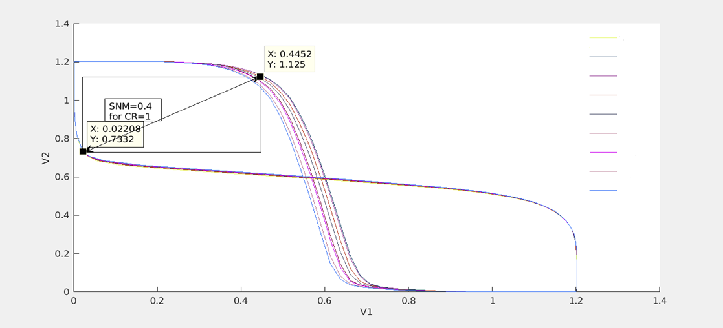
HSNM Calculation
CR=0.5
CR=0.875
CR=0.9
CR=1
CR=1.1
CR=1.25
CR=1.3
CR=1.5
CR=1.625

Slide 27
128K x 8 CMOS Static RAM
Under the guidance of Dr. Kaushik Saha
Team Members:
Shashank Varshney
Vijay Sharma
Saurabh Mathur
Srishti Gupta
Ramyani Mukherjee

Slide 28
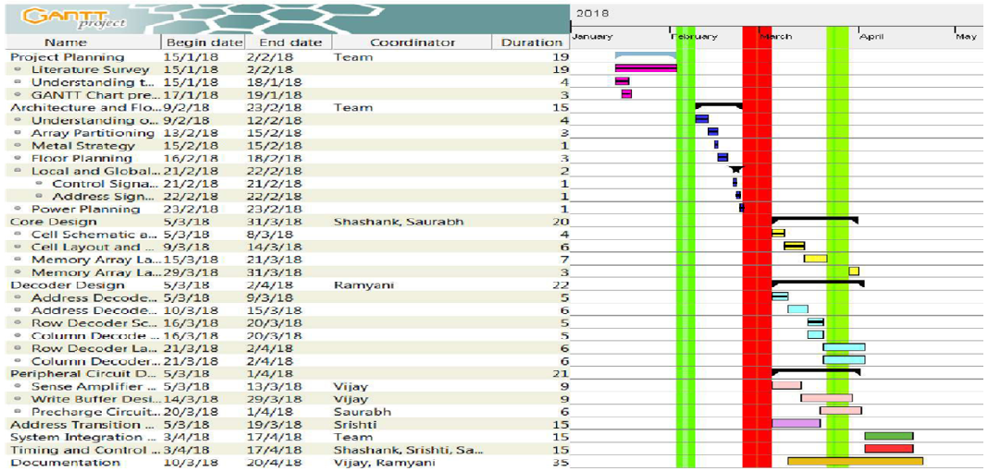

Slide 29
Read Static Noise Margin
CR | RSNM (V)
3 | 0.36
2.5 | 0.314
2 | 0.265
1.5 | 0.224
1 | 0.158

Slide 30
Write Static Noise Margin
PR | WSNM (V)
2 | 0.744
1.5 | 0.66
1 | 0.464
0.5 | 0.445

Slide 31
SNM at Process Corners
For PR=1, CR=2 SNM values at ss corner are:
HSNM=0.3536V
RSNM=0.293V
WSNM=0.432V

Slide 32
Power Planning
Hybrid grid for ground routing on metal layer7
Hybrid grid for VDD routing on metal layer8
Ref- Dr. Robert Reese [9] https://www.google.co.in/url?sa=t&rct=j&q=&esrc=s&source=web&cd=4&cad=rja&uact=8&ved=0ahUKEwjQ3Lemvd_ZAhVLKY8KHcyvBZYQFghLMAM&url=http%3A%2F%2Fece-research.unm.edu%2Fjimp%2Fvlsi_synthesis%2Fcontrib%2FMissStateStdCellTut.ppt&usg=AOvVaw2rM2jRk8ovHWVIv43zPlDs

Slide 33
SRAM Cell sizing
The access transistors were chosen to be of minimum size so as to minimize the bitline capacitance.
Considering acceptable noise margins pull-up ratio was chosen to be 1 and cell ratio was 2.
Optimum CR = 2 & PR = 1.0
Sizing of Transistors : L= 60 nm
Pull-up Transistors : W = 160 nm
Access Transistors : W = 80 nm
Drive Transistors : W = 160 nm

Slide 34
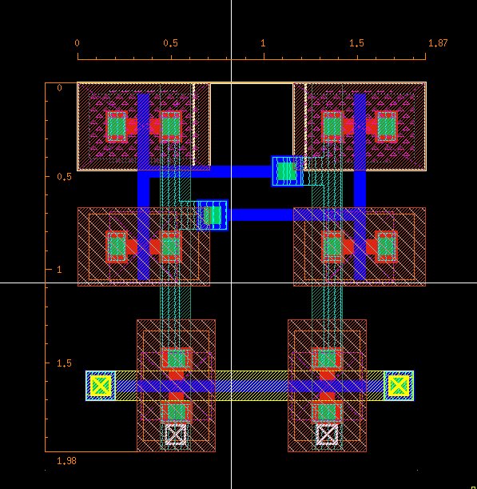
6T Cell Layout
Height=1.98 um
Width=1.87 um
Area= 3.70 um sq

Slide 35
Decoding Scheme
The total 17 address lines are divided as follows for decoding:
-A16 to A14 for memory bank decoding
-A13 to A9 for row decoding
-A8 to A0 for column decoding
A simple 3:8 decoder is to be used for memory bank selection.
A novel 5:32 decoder using a predecoder and an inverter replica based circuit is to be used for row decoding.
The above novel decoder circuit is to be used as a 9:512 decoder for column decoding too.

Slide 36
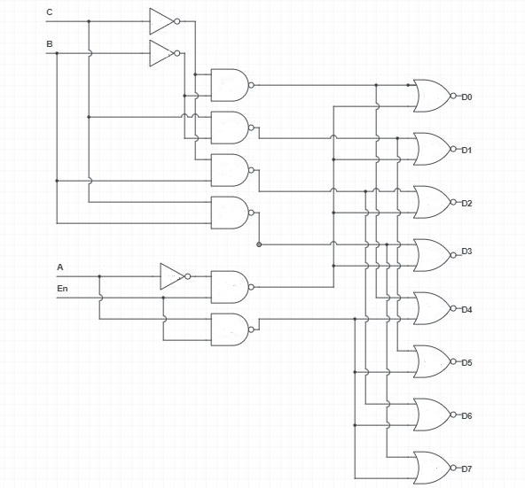
Memory Bank Selection using 3:8 decoder
Predecoding is done to reduce the fan-in of the logic gates.
Using the enable signal at the input stage reduces its fan-out and also minimizes power.
Implemented Schematic of 3:8 Decoder

Slide 37
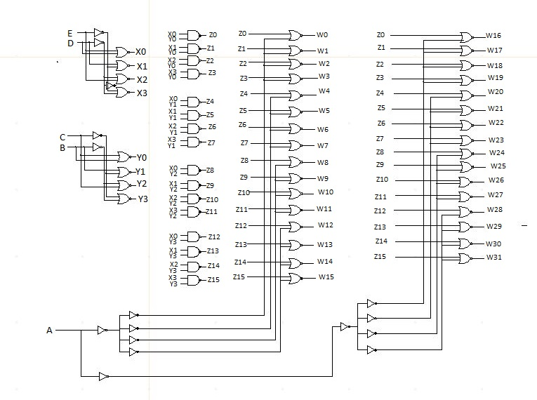
Novel 5:32 Decoder
Ref-[9] “Novel Design Technique of Address Decoder for SRAM ”, Arvind Kumar Mishra et.al, IEEE, 2014

Slide 38
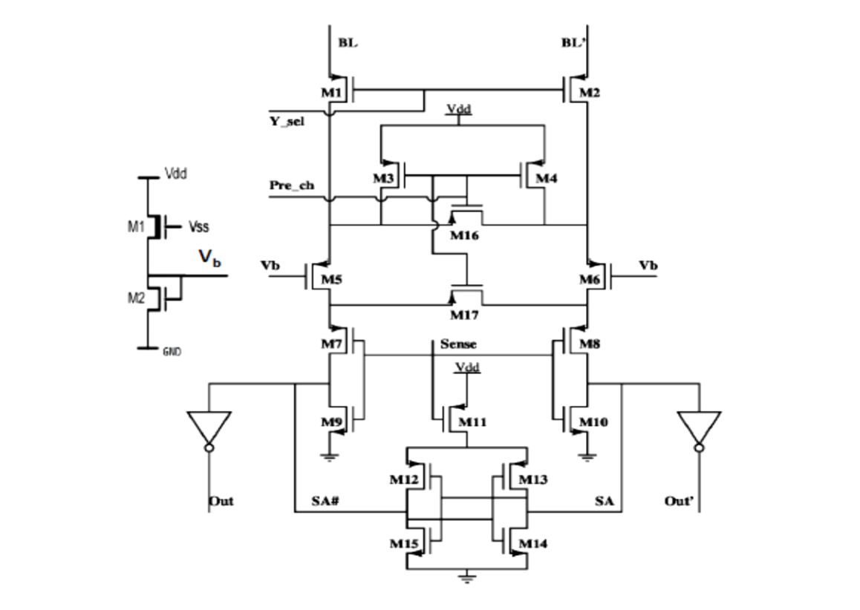
Sense Amplifier
Bias Voltage | Bit(ps) | Bit bar (ps)
0 | 23.59 | 28.1
0.4 | 49 | 20
0.6 | 132 | 67
0.8 | 132 | 132
Ref-[10] “High-Performance and Low-Voltage Sense-Amplifier Techniques for sub-90nm SRAM ”, Manoj Sinha et.al, IEEE, 2003
Table: CTSA delay tplh for bit and bit_bar for various values of bias voltage.

Slide 39
Sense Amplifier
Charge Transfer Sense Amplifier has been chosen.
18-20% faster than Voltage mode sensing. [10]
Works on the principle of conservation of charge and exploits the high bitline capacitances.
Simulations show that there is typically 30ps delay from sense enable signal to output.
The cross coupled inverters raise the signal to full CMOS level.

Slide 40
128K x 8 CMOS Static RAM
Under the guidance of Dr. Kaushik Saha
Team Members:
Shashank Varshney
Vijay Sharma
Saurabh Mathur
Srishti Gupta
Ramyani Mukherjee

Slide 41
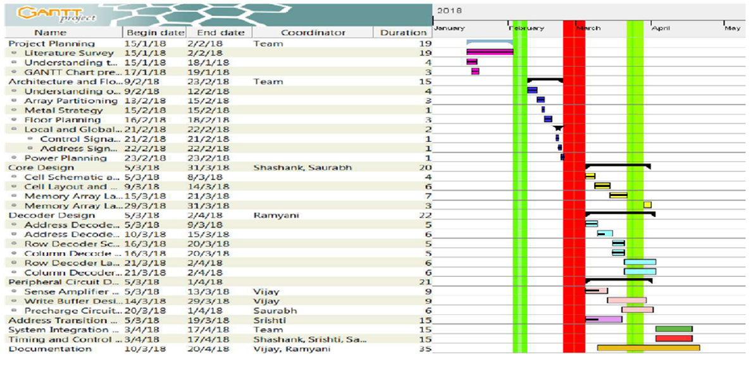

Slide 42
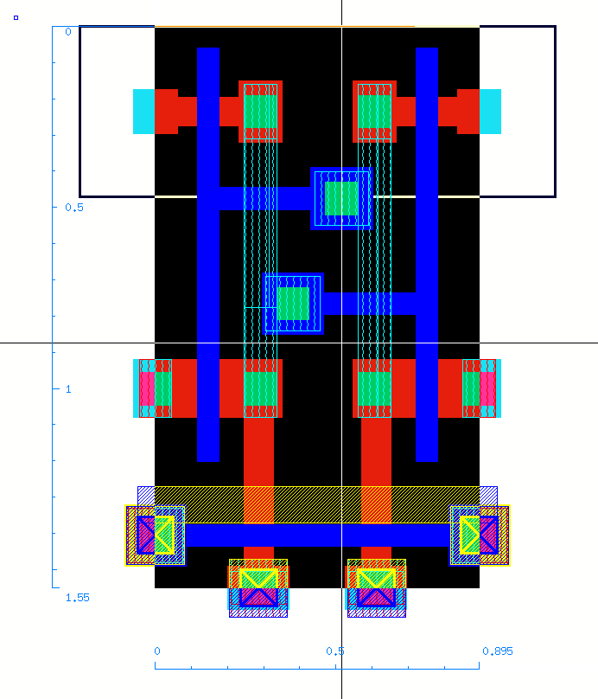
6T Cell Layout (Optimized)
Length= 1.55 um
Width= 0.895 um
Area= 1.387 um sq

Slide 43
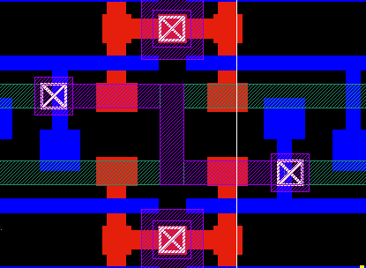
Bit line Twisting

Slide 44
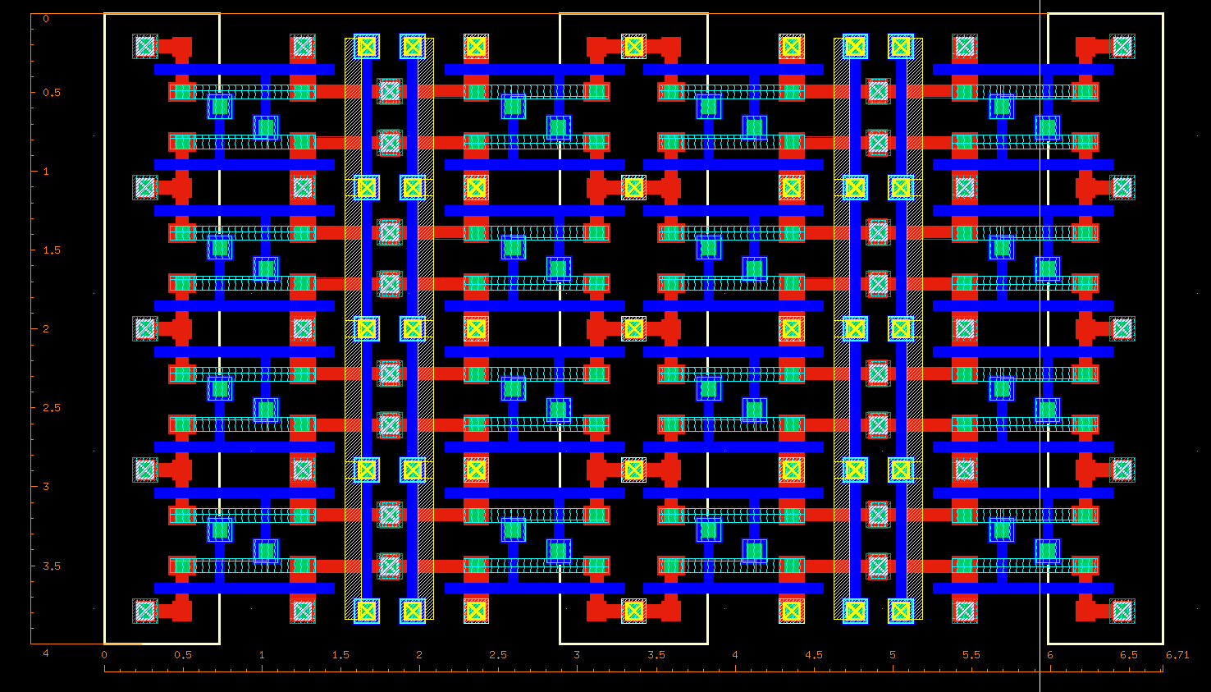
4X4 Cell Layout
Length= 6.71 um
Width= 4 um
Area= 26.84 um sq

Slide 45
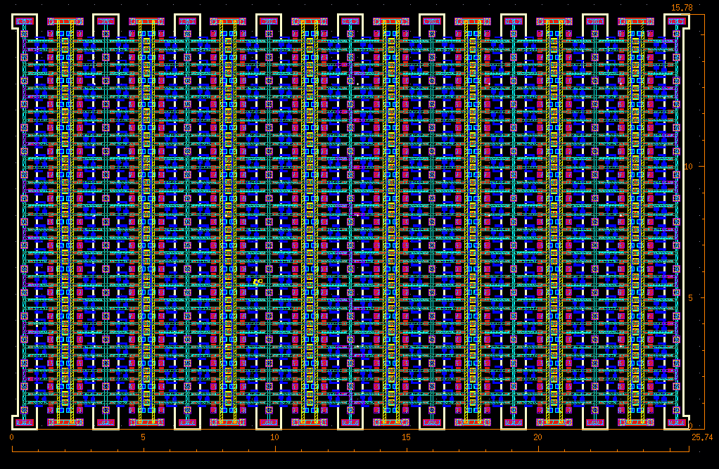
16X16 Cell Layout
Length=25.74um
Width= 15.78 um
Area= 406.17 um sq

Slide 46
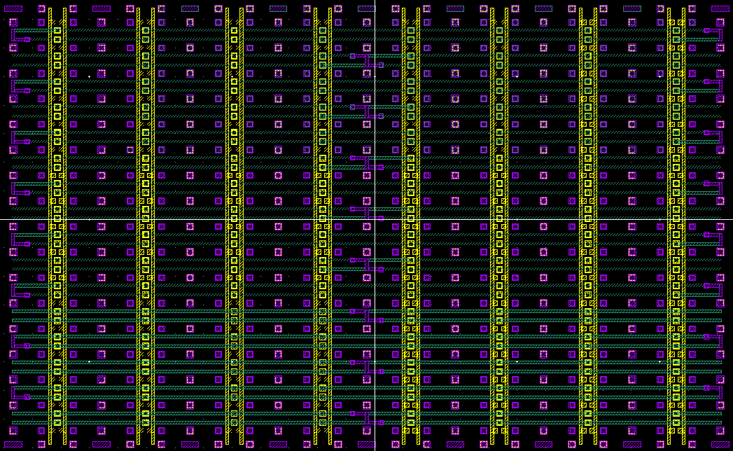
Bit line
Bit bar line
Word line

Slide 47
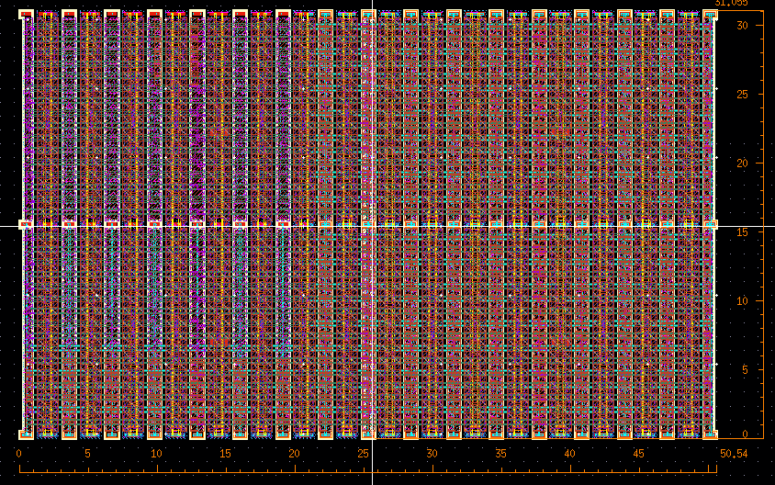
32X32 Cell Layout
Length=50.54um
Width= 31.05 um
Area= 1569.26 um sq

Slide 48
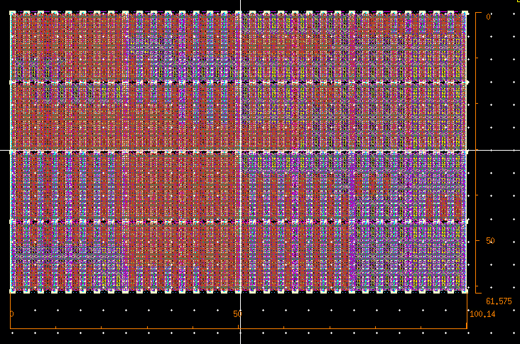
64X64 Cell Layout
Length=100.14 um
Width= 61.575 um
Area= 6166.12 um sq

Slide 49
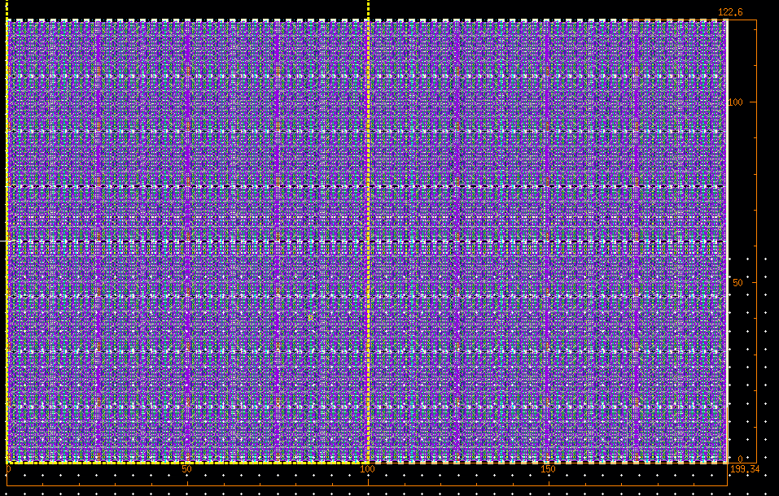
128X128 Cell Layout
Length=199.34 um
Width= 122.6 um
Area= 24439.08 um sq

Slide 50
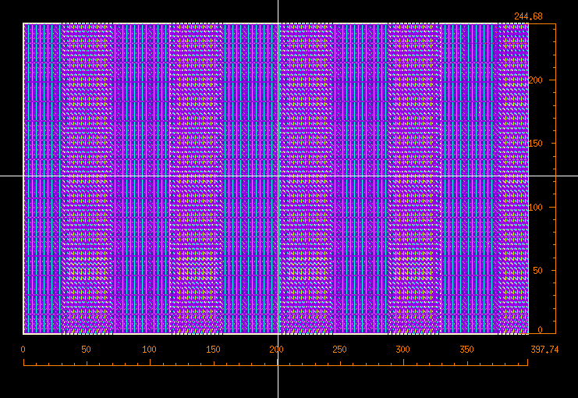
256X256 Cell Layout
Length=397.74 um
Width= 244.68 um
Area= 0.097mm sq

Slide 51
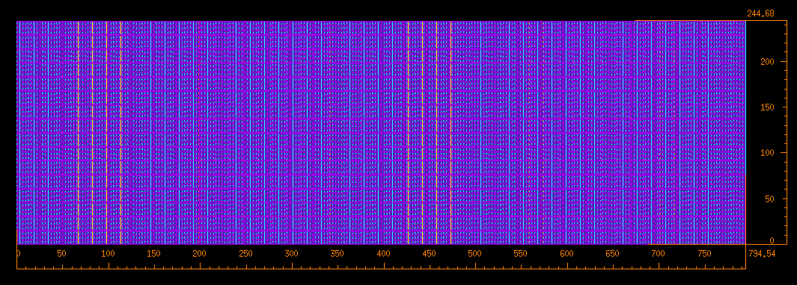
Core Layout
Length=794.54 um
Width= 244.68 um
Area= 0.194 mm sq
Effective area of one cell = 1.427 um sq

Slide 52
Word Line Driver Design
F= f^{N}
N=No. of stages
We calculated f=3.47
Value chosen f=4

Slide 53
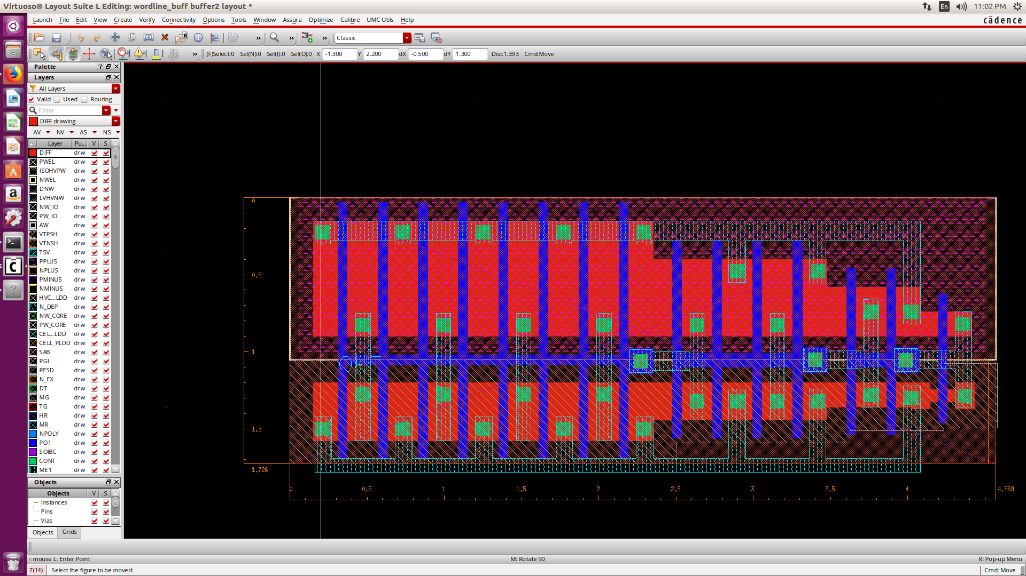
Word Line Driver Layout
Length= 4.569 um
Width= 1.725 um
Area= 7.88 um sq

Slide 54
Delay Analysis at Process Corners
Process Corner | Pulse Width (in ps)
tt | 85
ff | 72
ss | 110
snfp | 89.5
fnsp | 87.5

Slide 55
Reference Voltage Circuit
We need 0.6 V for CTSA and Delay element.
The following circuit was designed by us and tested for variations.
The circuit gave a nominal output voltage of 550mV.
Temperature varied from -25 to 85 C.
Voltage varied +-10mv at extremes.

Slide 56
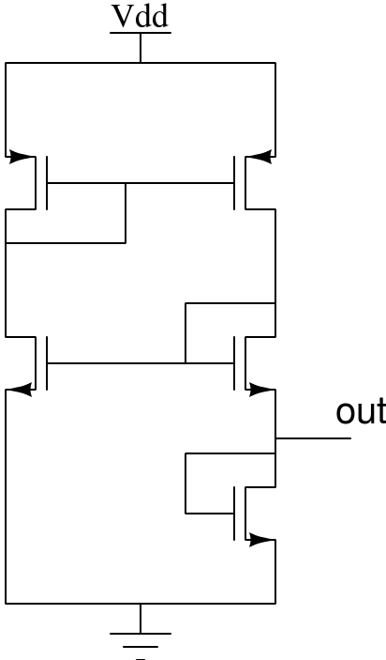
Reference Voltage Circuit
Monte Carlo sampling was done for 1million samples at random for process and mismatch.
Monte Carlo results:
Mean value=550.9mV
Standard deviation of 6mV.
M1
M2
M3
M4
M5

Slide 57
Reference Voltage Circuit
Temperature (degree C) | Voltage (mV)
-25 | 560
0 | 556
10 | 554
20 | 552
40 | 548
60 | 545

Slide 58
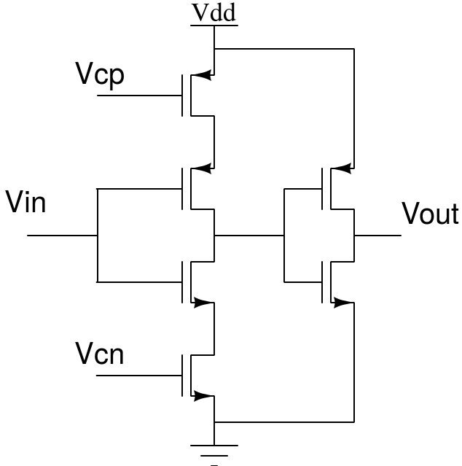
Delay Element based on Current Starved Inverter
Vcp=550 mV
Vcn= 550 mV
NMOS w=80n, l=60n
PMOS w=160n, l=60n
Delay Obtained= 100ps

Slide 59
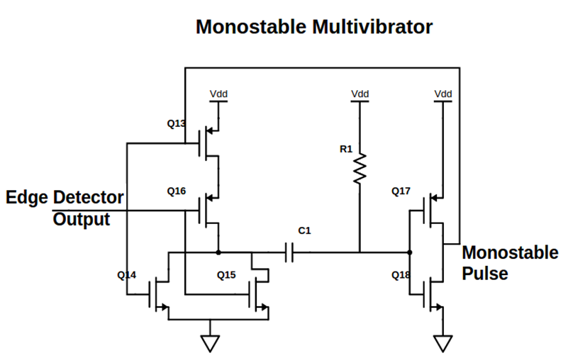
Monostable Multivibrator
Used to stretch the output pulse of the ATD to get the desired pulse width.
The designed circuit specifications:
R1 = 75K Ohms; C1 = 50fF
NOR gate
NMOS: w = 80n l = 60n
PMOS: w = 320n l = 60n
INVERTER
PMOS: w = 440n, l = 60n
NMOS: w = 80n, l = 60n
INPUT PULSE
Period = 10ns
pulse width = 100ps
rise/fall time = 5ps

Slide 60
Pulse Width Analysis at Process Corners
Process Corner | Pulse Width (in ns)
tt | 2.02
ff | 1.93
ss | 1.97
snfp | 2.22
fnsp | 1.78

Slide 61
128K x 8 CMOS Static RAM
Under the guidance of Dr. Kaushik Saha
Team Members:
Shashank Varshney
Vijay Sharma
Saurabh Mathur
Srishti Gupta
Ramyani Mukherjee

Slide 62
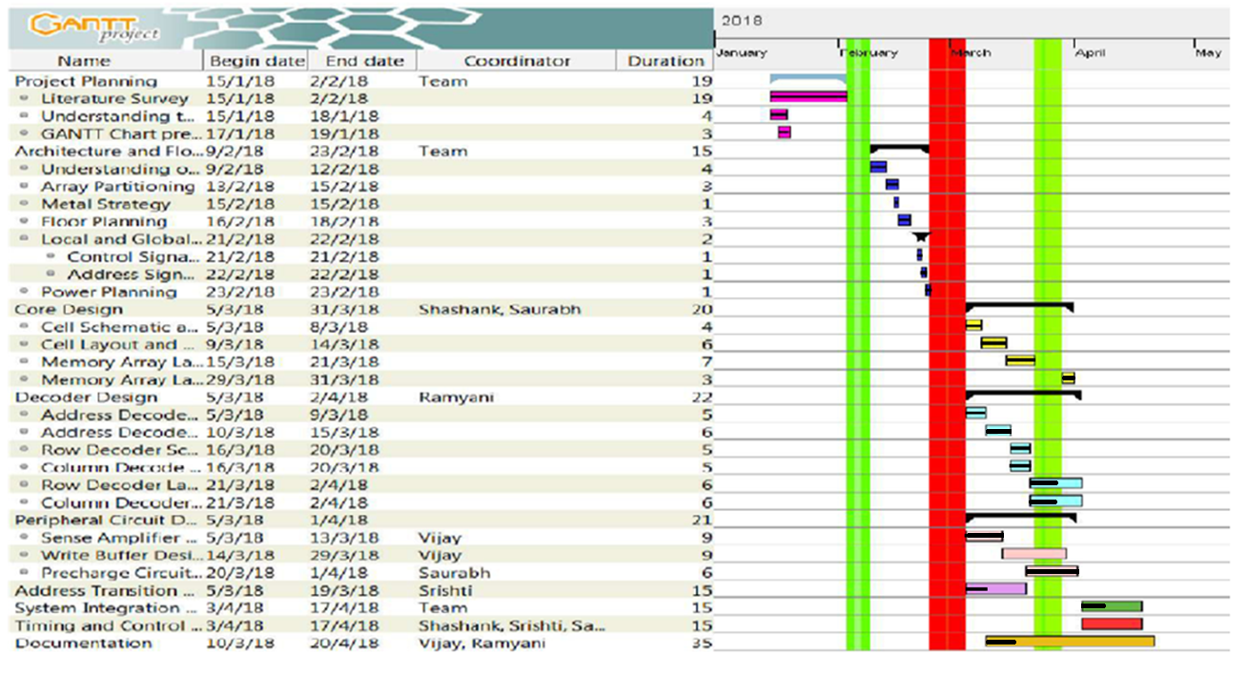

Slide 63
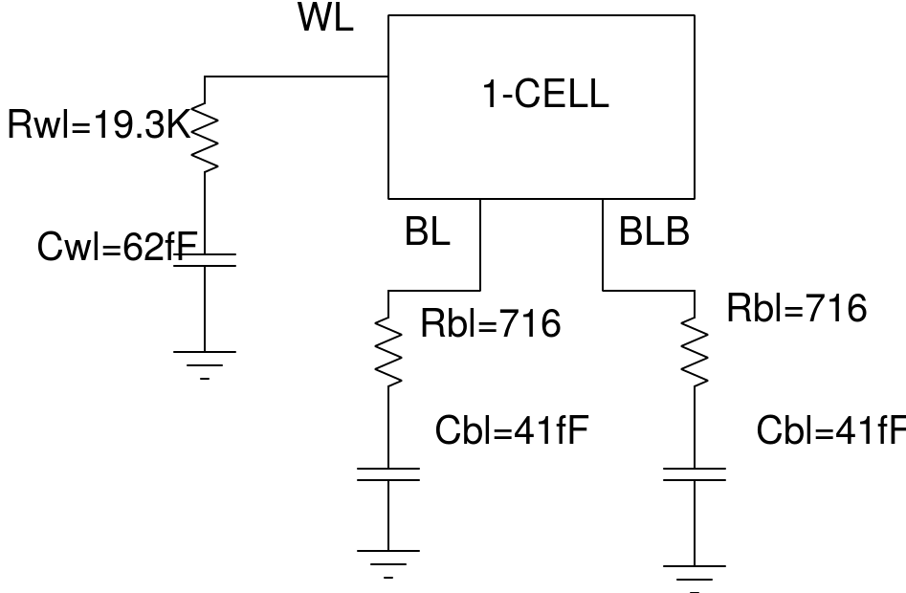
Timing Analysis of Core
Length of bitline = 398um
Width of bitline = 0.1um
Length of wordline = 490.42um
Width of wordline = 0.1um
CORNER | READ DELAY (ns) | WRITE DELAY (ps)
tt | 0.642 | 40
ss | 1.01 | 51
ff | 0.5 | 30
snfp | 0.8 | 46
fnsp | 0.53 | 33
Lumped Core Model

Slide 64
Pulse Width Analysis of ATD
Capacitor (MIMCAP) (5x5 um sq) value used is 51.6fF
Resistance (RNHR_LL) (480nm x 5 um x 7) value used is 74.6 KΩ
At tt corner
At 27 deg C
TEMPERATURE (deg C) | PULSE WIDTH (ns)
-20 | 2.0990
0 | 2.0689
27 | 2.0330
40 | 2.0176
80 | 1.9844
CORNER | PULSE WIDTH (ns)
tt | 2.046
ss | 1.977
ff | 1.956

Slide 65
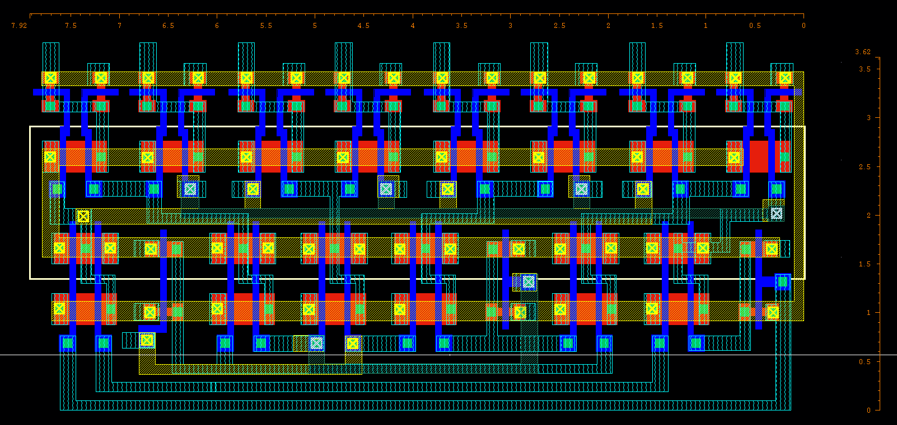
Block Decoder Layout
Length= 7.92um
Width= 3.62um
Area= 28.67 um sq

Slide 66
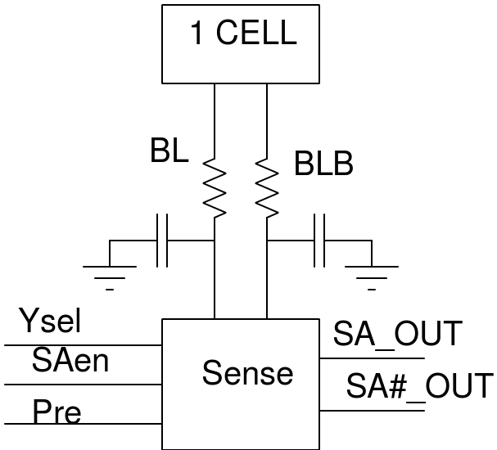
Testing CTSA with Lumped Model of Core
Sense amplifier was tested with worst case of lumped model of the core.
Bitline resistance was taken as 600ohm
Bitline capacitance is 35f F
Worst case delay from sense enable signal to sense amplifier output is 200ps.

Slide 67
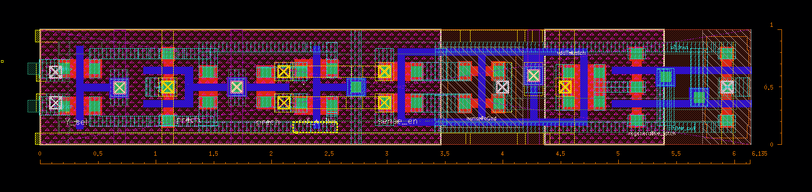
Sense Amplifier Layout
Length = 6.135 um
Width = 1 um
Area = 6.135 um sq

Slide 68
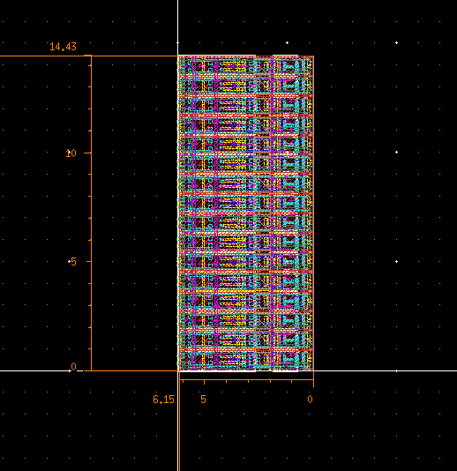
Array of 16 Sense Amplifiers
Length= 14.43 um
Width= 6.15 um
Area= 88.7445 um sq
Effective area of 1 CTSA is 88.7445/16 i.e.
5.546 um sq

Slide 69
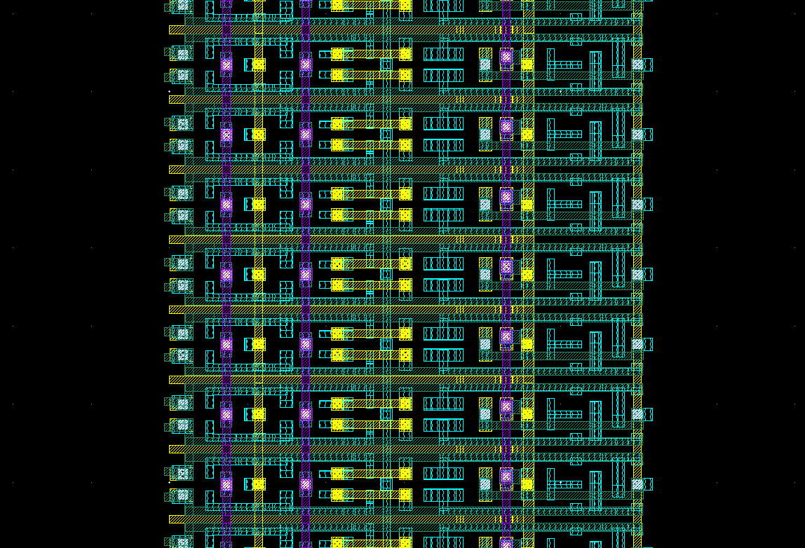
Y Select
Precharge
Reference Voltage
GND
VDD
Sense Enable
VDD
Bitline bar
Bitline

Slide 70
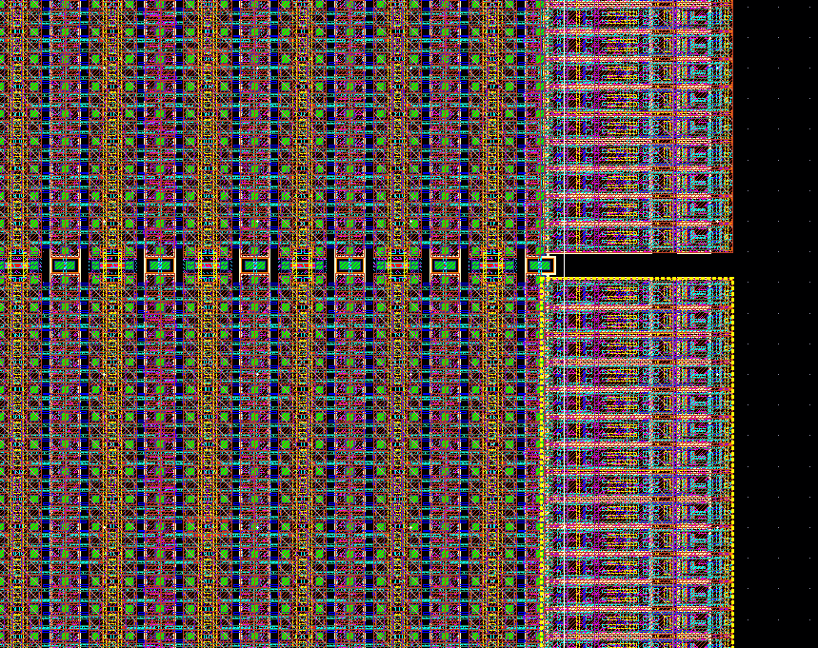
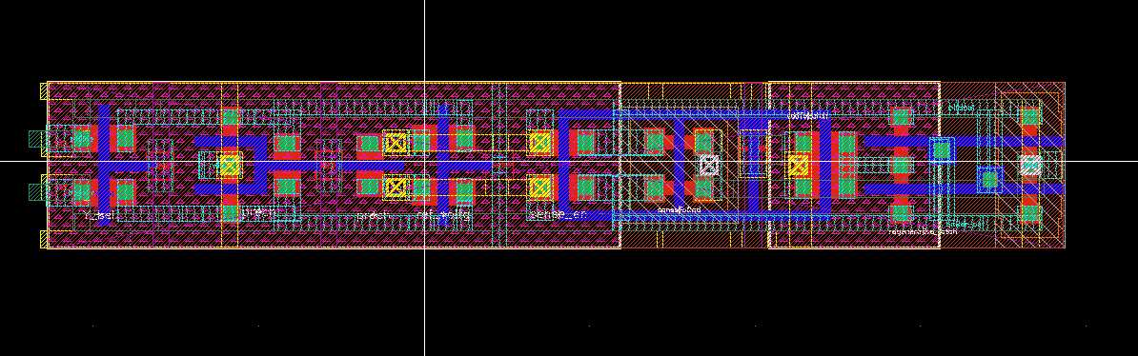
Integration of CTSA with Core
Empty space

Slide 71
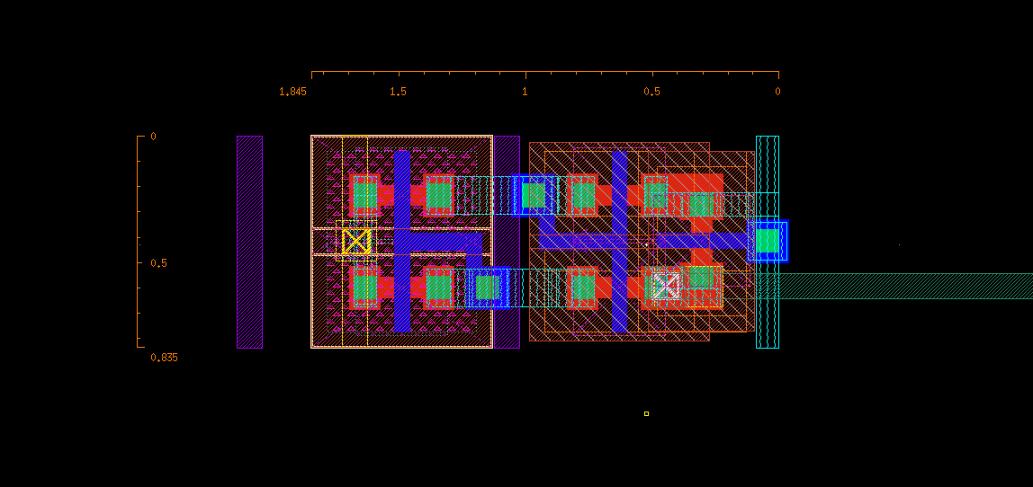
Reference Voltage Generator Layout
Length = 1.845 um
Width = 1.845 um
Area = 1.54 um sq

Slide 72
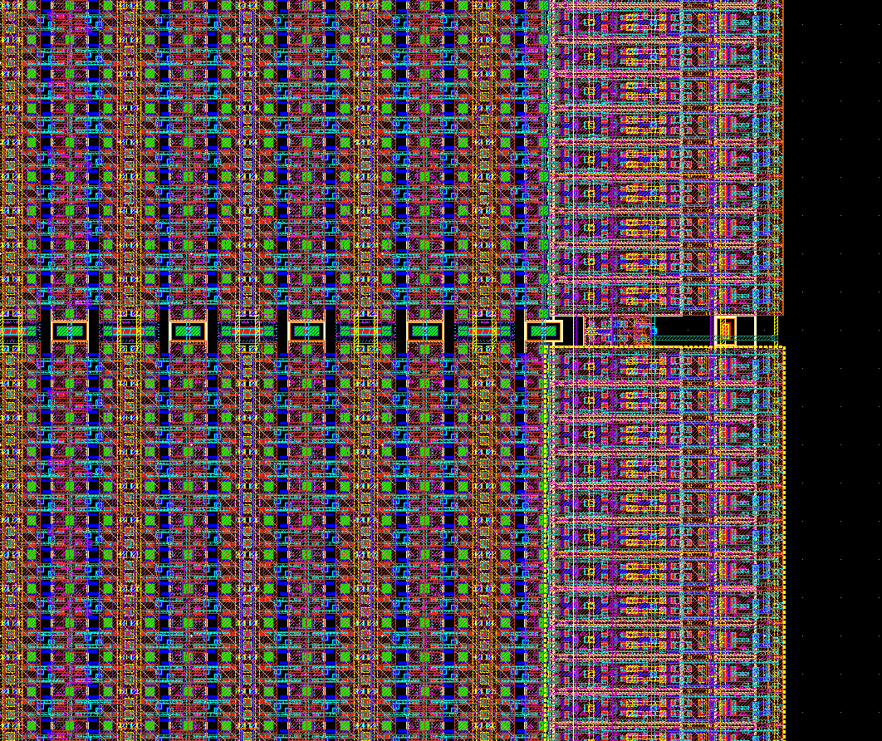

Integration of Core with Reference Voltage Generator

Slide 73

Precharge Circuit Layout
Length = 0.785 um
Width = 0.765 um
Area = 0.6 um sq

Slide 74

Integration of Core with Precharge Circuit

Slide 75

Wordline Driver Layout
Length = 6.06 um
Width = 1.38 um
Area = 8.3628 um sq

Slide 76

Integration of Core with Wordline driver

Slide 77

Wordlines
GND
VDD
Inputs from Row Decoder

Slide 78
128K x 8 CMOS Static RAM
Under the guidance of Dr. Kaushik Saha
Team Members:
Shashank Varshney
Vijay Sharma
Saurabh Mathur
Srishti Gupta
Ramyani Mukherjee

Slide 79


Slide 80

Row Decoder (6:64)
Length = 91.075 um
Width = 14.025 um
Area = 1277.32 um sq

Slide 81


Slide 82


Slide 83

Column Decoder (8:256)
Length = 396.455um
Width = 28.185 um
Area = 11,174.0842 um sq.

Slide 84


Slide 85


Slide 86

Integration of Column Decoder

Slide 87
Decoder Timing Analysis
6:64 Row Decoder
Before PEX at tt Corner | After PEX at tt Corner
192ps | 205.5ps
8:256 Column Decoder
Before PEX at tt Corner | After PEX at tt Corner
198ps | 218ps

Slide 88


Pass Transistor Array

Slide 89

Integration of Pass Transistors

Slide 90

ATD Layout
Length = 5.99 um
Width = 1.975 um
Effective Area = 11.83 sq um

Slide 91


Slide 92


Slide 93

Monoshot Multivibrator Layout
Length = 16 um
Width = 13.1 um
Area = 209.6 sq um

Slide 94
Timing Analysis
Difficult to simulate for the complete core because of less computation power.
Simulation done by dividing into blocks:
32 bit horizontal array
32 bit vertical array
16 bit + sense amplifier + PTs
16 bit + word-line buffer
16 bit corner array with precharge

Slide 95
Timing Analysis(Contd.)
Analysis done in “typical” corner at 27 C.
Read Delay | Write Delay
4ns | 380ps

Slide 96

Timing Waveforms : Block Decoder

Slide 97

Timing Waveforms : Column Decoder

Slide 98

Timing Waveforms : Row Decoder

Slide 99

Timing Waveforms : ATD

Slide 100

Monoshot Layout

Slide 101

Timing Waveforms : Monoshot

Slide 102

Timing Waveforms : Read Delay Worst Path

Slide 103

Timing Waveforms : Write Delay Worst Path

Slide 104
References
[1] “Low-Leakage asymmetric SRAM Cell”, Azizi et.al. IEEE TVLSI vol.11 no.-4, 2003.
[2] “Static noise margin analysis of SRAM cell”; Seevnick et.al. IEEE JSSC vol.-22 no.-5, 1987.
[3] “Robust low power CMOS Precharge Logic”, Berg et.al. IEEE 2013.
[4] Rabaey, Chandrakasan and Nikolic, “Designing Memory Array Structures” in Digital Integrated Circuits a Design Perspective, 2nd ed.,vol. 1. Noida, Pearson India, 2016, pp. 657-662.
[5] “Gain-Enhancement Differential Amplifier Using Positive Feedback”, Phuoc T. Tran et. al. in MWSCAS, IEEE, 2012.
[6] “Novel Design Technique of Address Decoder for SRAM”, Arvind Kumar Mishra , Debiprasad Priyabrata Acharya , Pradip Kumar Patra, 2014 IEEE International Conference on Advanced Communication Control and Computing Technologies (ICACCCT).
[7] Betty Prince, “Basic Memory Architecture and Cell Structure” in Semiconductor Memory: Design and Application 2nd ed.
[8] “A word-line boost driver designed for Low Operating Voltage 6T- SRAMs” Shakir et.al. MWSCAS- IEEE 2012.

